Slide 1
Rank sum test

Slide 2
First, introduce Friedman test and rank correlation

Slide 3
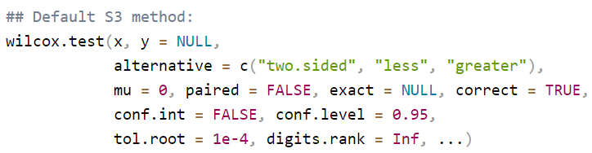

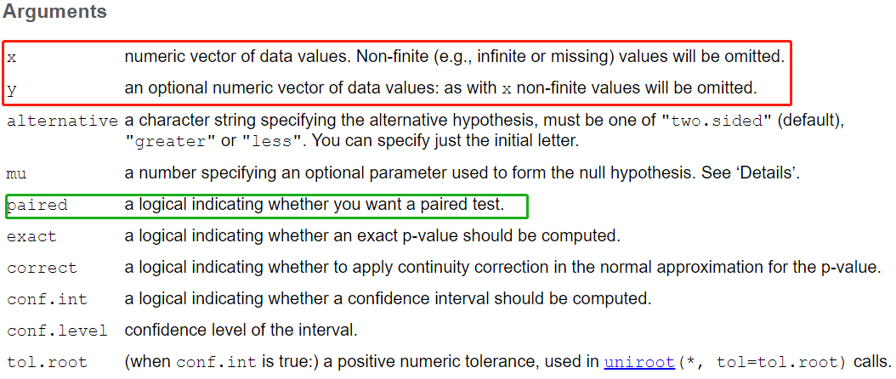

Slide 4


Slide 5
For paired study
Exercise 1: have a data, which contains the weight of 10 mice before and after the treatment.
# Weight of the mice before treatment before <-c(200.1, 190.9, 192.7, 213, 241.4, 196.9, 172.2, 185.5, 205.2, 193.7)
# Weight of the mice after treatment after <-c(392.9, 393.2, 345.1, 393, 434, 427.9, 422, 383.9, 392.3, 352.2)

Slide 6
Exercise 2: the NIHSS scores of 10 AIS patients with good outcome and 12 with poor outcome
Favorable outcome |  |  | Poor outcome
NIHSS score | Rank |  | NIHSS score | Rank
1 | 1 |  | 2 | 4.5
1 | 2 |  | 3 | 8
2 | 4.5 |  | 4 | 10
2 | 4.5 |  | 5 | 11
2 | 4.5 |  | 9 | 14
3 | 8 |  | 10 | 16
3 | 8 |  | 10 | 16
7 | 12 |  | 11 | 18
8 | 13 |  | 11 | 19
10 | 16 |  | 11 | 20
 |  |  | 12 | 21
 |  |  | 12 | 22
n₁=10 | T₁=73.5 |  | n₂=12 | T₂=179.5

Slide 7
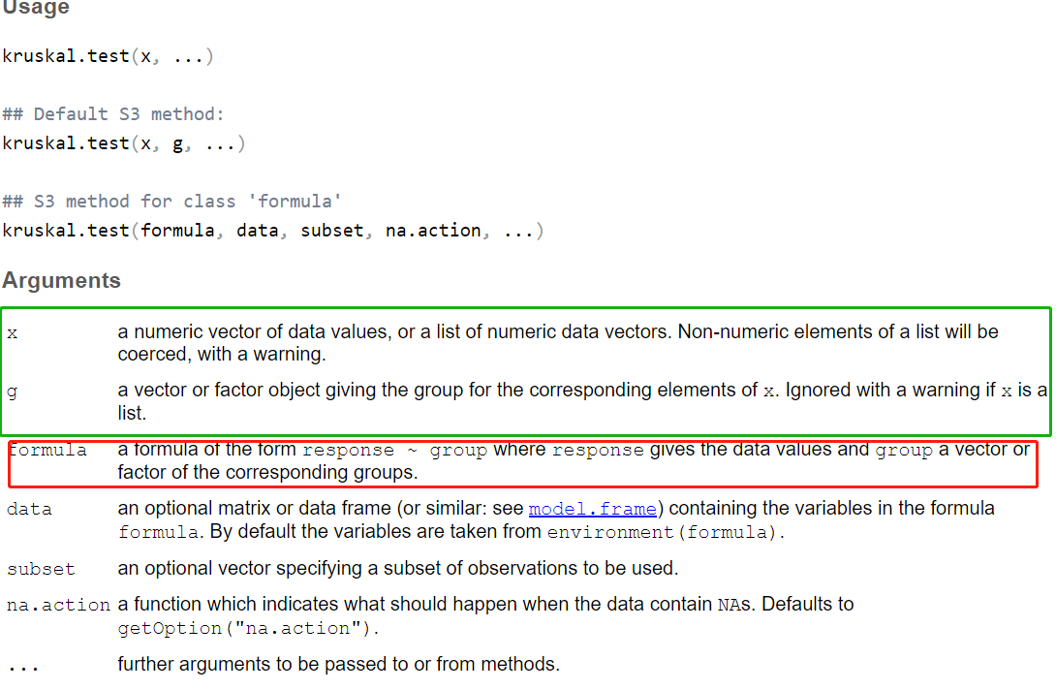
Kruskal-Wallis test

Slide 8
Multiple comparison test between treatments or treatments versus control after Kruskal-Wallis test
Dunn test for multiple comparisons
Probably the most popular test for this is the Dunn test, which is performed with the dunnTest function in the FSA package. Adjustments to the p-values could be made using the method option to control the familywise error rate or to control the false discovery rate.
Nemenyi test for multiple comparisons
Zar (2010) suggests that the Nemenyi test is not appropriate for gr
oups with unequal numbers of observations.
Pairwise Mann–Whitney U-tests
To prevent the inflation of type I error rates, adjustments to the p-values can be made using the p.adjust.method option to control the familywise error rate or to control the false discovery rate.

Slide 9
Exercise 3. The spleen lymphocyte proliferation stimulated by heparin enzyme (HPA) （measured as ³H absorb value ）
Group A | Rank | Group B | Rank | Group C | Rank
（1） | （2） | （3） | （4） | （5） | （6）
3012 | 11 | 2532 | 8 | 8138 | 15
9458 | 18 | 4682 | 12 | 2073 | 6
8419 | 16 | 2025 | 5 | 1867 | 4
9580 | 19 | 2268 | 7 | 885 | 2
13590 | 21 | 2775 | 9 | 6490 | 13
12787 | 20 | 2884 | 10 | 9003 | 17
6600 | 14 | 1717 | 3 | 690 | 1
R_{i} | R₁＝119 |  | R₂＝54 |  | R₃＝58
n_{i} | 7 |  | 7 |  | 7

Slide 10
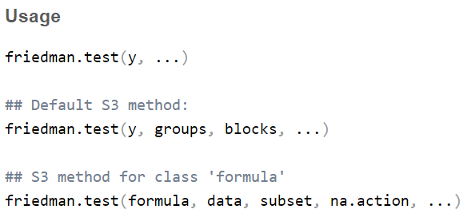
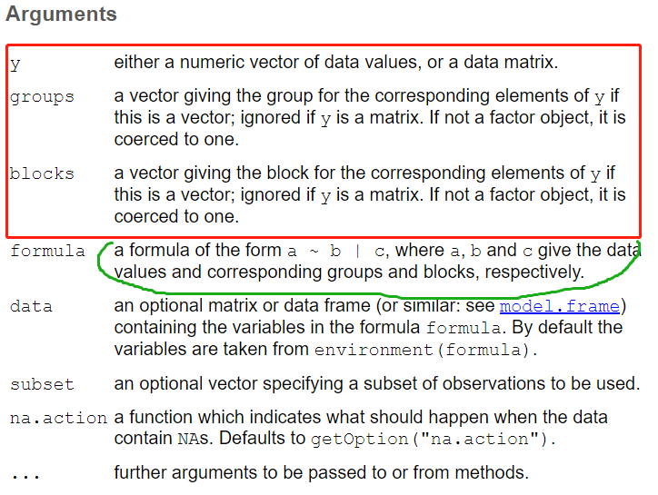
Freidman test

Slide 11
Exercise 4 Comparison of the comprehensive scores of 10 medical students on the teaching effects of three basic medical courses
student | Anatomy |  | Physiology |  | Histoembryology
 | score |  | score |  | score
1 | 4.0 |  | 4.0 |  | 5.0
2 | 2.5 |  | 4.0 |  | 4.0
3 | 4.0 |  | 3.5 |  | 4.5
4 | 3.5 |  | 4.0 |  | 5.0
5 | 3.5 |  | 3.0 |  | 4.0
6 | 2.5 |  | 3.5 |  | 3.5
7 | 4.0 |  | 3.5 |  | 3.5
8 | 3.5 |  | 3.5 |  | 4.5
9 | 3.0 |  | 4.0 |  | 4.0
10 | 2.5 |  | 3.0 |  | 4.0
R_{i}
Notes:
/əˈnætəmi/
/ˌem.briˈɑː.lə.dʒi/

Slide 12

Rank correlation-spearman

Slide 13
Exercise 5. scores for sleep quality and anxiety among 10 students
id | Sleep quality |  | Anxiety
 | score x |  | score y
（1） | （2） |  | （4）
1 | 4 |  | 5
2 | 8 |  | 8
3 | 5 |  | 6
4 | 8 |  | 4
5 | 3 |  | 4
6 | 2 |  | 3
7 | 3 |  | 3
8 | 7 |  | 7
9 | 3 |  | 0
10 | 2 |  | 1
Total | 45 |  | 41

